Slide 1


Q3 Report & Full Design Doc
Jinseo Park
v2020-06-18

Slide 2
Table of Contents
Introduction
Goal of the Game
Micro Mechanics
Entity and Tile
Grid and Movement
Conformation
Visibility, Occupation and Blocking
Attacks
Melee
Ranged
Other
Weak spots
Buffs
Combat Mechanic : The Pipeline
Instructions
Enemy AI/Pathfinding
Macro Mechanics
Spawning
Waves of Enemies
Resource/Energy
Resource/Remnants
Resource/HP
Scavenge
Link: List of Enemy Entities
Link: List of Instructions
Link: List of Buffs
List of Tiles
List of Enemies
Victory Condition

Slide 3
Introduction
Pipeline Dreams is a 3D Grid-Turn-Based Roguelike.
The player is a robot which suddenly became self-aware in the middle of what remains of a technologically advanced civilization. You venture through the immense underground network which survived the apocalypse. Unfortunately, the creatures living in it don’t seem so friendly.

Slide 4
Goal of the Game
For every run, the goal is to:
Survive from waves of enemies and lack of energy.
Defend your generator, the only reliable source of energy.
Run ends (Victory) after a certain number of waves. (Or when one of the hidden conditions is fulfilled)

Slide 5
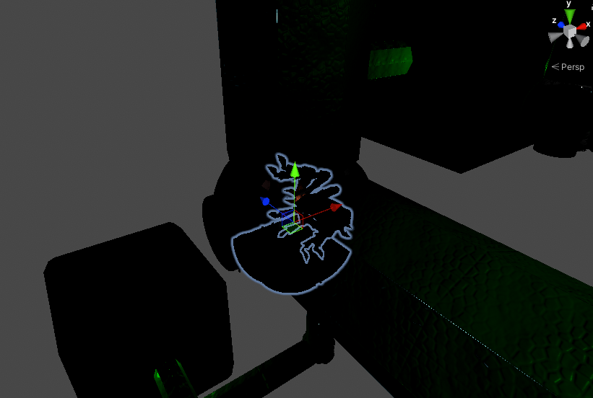
Entity and Tile

Slide 6
Entity and Tile
All relevant game objects, like player, mobs, and tiles, are entities.
Tile is a special type of entity that is generated in world gen and could not be moved or destroyed.

Slide 7
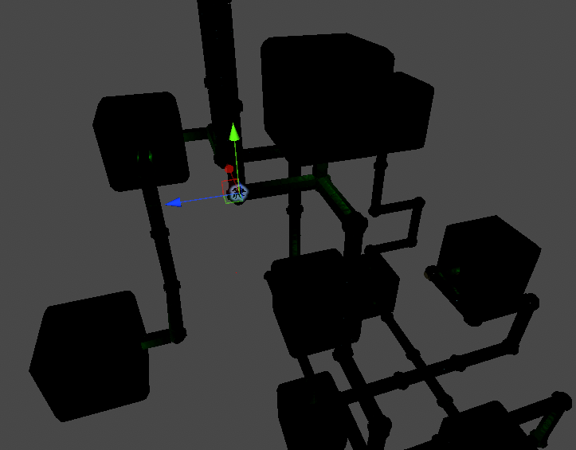
Grid and Movement

Slide 8
Grid and Movement
All entities in the game stay on cells of the 3D grid.
Entities could go forward if possible.
Tiles are generated on each cell, blocking entities from escaping the world.
Each cell is 2mx2mx2m and is adjacent with other cells.

Slide 9
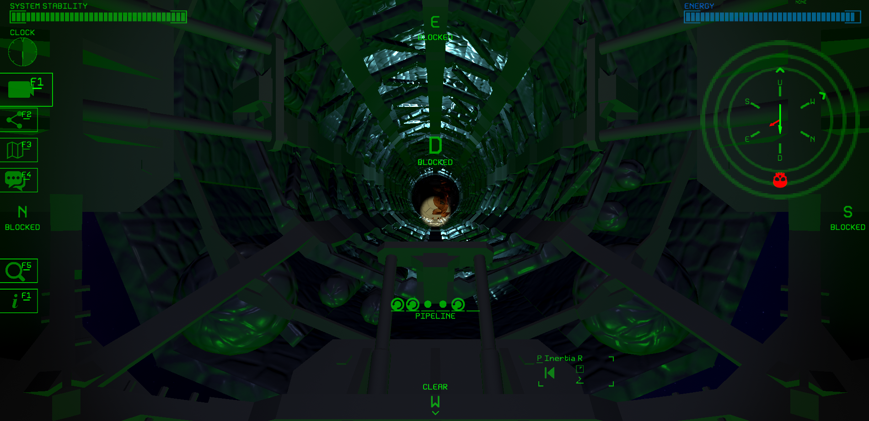
Conformation
Player is sticking on W side of the pipe, looking at D direction. The spider is sticking on S side, also looking at D direction. The spider could not see me, but I could see him.

Slide 10
Conformation
All entities could look at one of the six directions: North, South, East, West, Up, Down.
When entities rotate, they could rotate 90 degrees, looking at either up, down, left, or right.
Entities stick on one of the four sides of the pipe.
Thus, entities could have 24 different conformations.

Slide 11
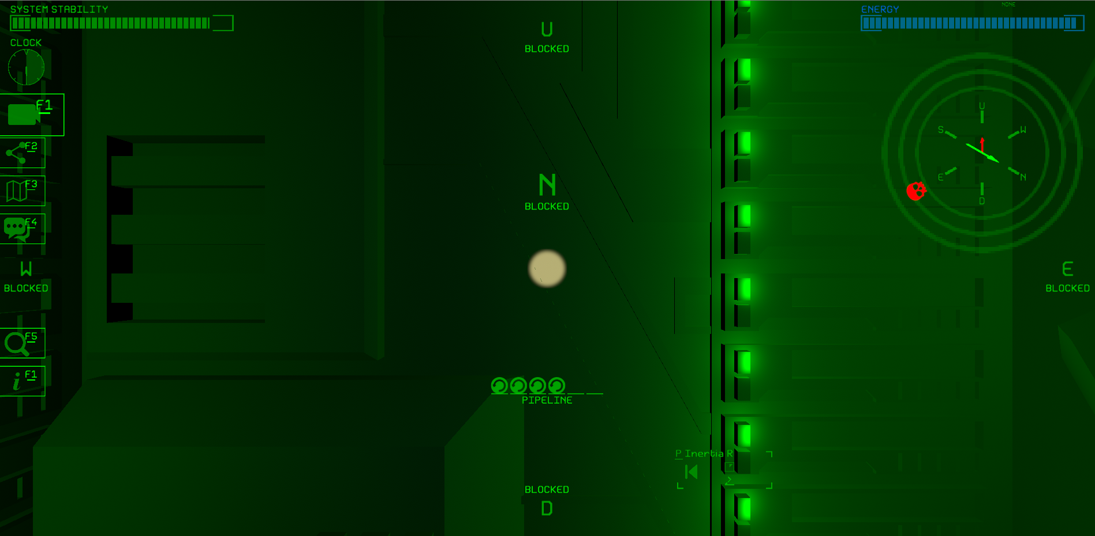
Visibility, Occupation, and Blocking
The wall the player is looking at is not occupying his space, but blocks him from going forward. The wall and the player are in the same cell, both looking at N.

Slide 12
Visibility, Occupation, and Blocking
Most moving entities occupy space. Two space-occupying entities could not be in the same cell.
Most Tiles does not occupy space.
For an entity to be visible to another entity, the line of sight between them should not be blocked. Also, they must be looking at each other.
Space-occupying entities block the line of sight.
Some tiles, like closed doors and walls, block the line of sight. Other tiles, like the pipe, don’t.
Only tiles could ‘block’. Tiles with ‘block’ attribute also blocks entities moving in that direction. This has nothing to do with occupation.

Slide 13
Supporting
Non-flying enemies could only stay on supporting tiles. They could not rotate or move into unsupportive tiles.
All Pipe and Wall tiles are supportive.
Open wall tiles are supportive, but they does not block.

Slide 14
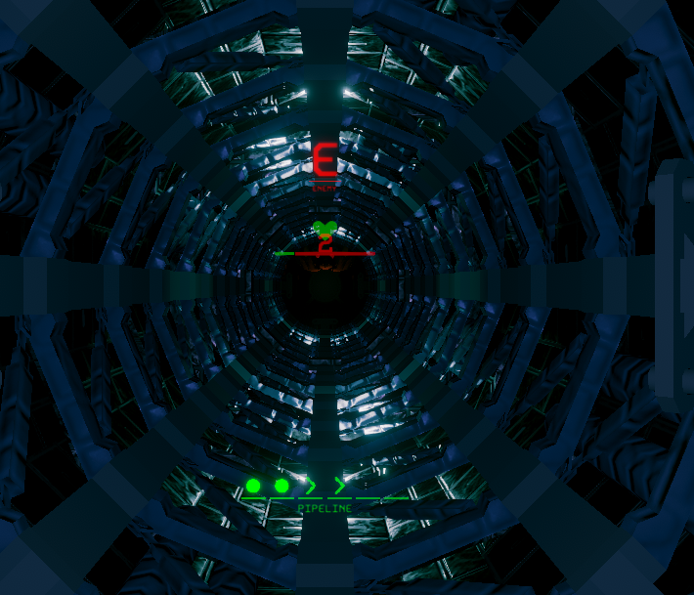
Attacks

Slide 15
Attacks
An entity could attack another entity, decreasing the target’s HP.
Attacks always hit once performed.
There are no stats such as accuracy, crit, defense, or resistance.

Slide 16
Melee Attacks
Melee attacks are available when
The performer is adjacent to the target.
The performer is looking to the target.
The target is sticking on the side closest to the performer, or sticking on the same side with the performer.

Slide 17
Ranged Attacks
Ranged attacks are available when
The target is visible to the performer.
The performer is looking to the target.

Slide 18
Other Attacks
Field Attacks
Fragments damage all entities in the target cell.

Slide 19
Weak spots
Attacks hit harder or weaker in certain directions.
Most entities can endure attacks coming from their front.
Player is weak when hit from behind.
Spiders are weak when hit from below.

Slide 20
Buffs
Buffs are entity-specific effect lasting for a certain number of turns.

Slide 21

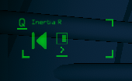
Combat Mechanic : The Pipeline

Slide 22
Combat Mechanic : The Pipeline
The pipeline is a queue of symbols.
Whenever the player perform an action, the corresponding symbol is stored in the pipeline.
Players spend symbols according to the instructions they have, performing instruction-specific actions.
Enemies could deter the player performing desired action by pushing symbols into the pipeline.

Slide 23
Combat Mechanic : The Pipeline
Symbols
Wait(W)
Rotate(R)
Move(V)
Melee Attack(M)
Ranged Attack(A)
Defense(D)
Control(C)
Manually Performed Actions
Wait(Default: .), Move(Default: space), Rotate(Default: arrows)

Slide 24
Instructions
Each instruction is coded in 2-6 symbols.
Instruction is executed whenever the pipeline has corresponding sequence of symbols, consuming the symbols(but there is execution priority between instructions).
Instructions could move or rotate entities, attack, cast buff/debuffs.
Instructions consume energy and time.
Instructions could also add symbols to the pipeline, enabling consecutive execution of multiple instructions.

Slide 25
Instructions
Player can carry up to 8 instructions. Cannot add more instructions when full.
Player’s instructions are ordered in execution priority.
Newly added instructions are added at the end of the execution order.
When an instruction is deleted, all instructions behind it move forward one in execution order.

Slide 26
Instructions
Example set of instructions(descending order):
Disintegrate: WRW → Range Attack, push A
Retract: WA → Move backward, push V
Traceback: WV → Rotate 180 degrees, push R
Conversion: RRR → Gain speed buff.
Player type RWWWRW.
Disintegrate, Retract, Traceback, Conversion.

Slide 27
CF) Resemblence with CPU pipeline
The pipeline == Program
Instruction Set
After a full execution, multiple instructions have been executed.
Bubble
Flow Dependency, Control Hazard.

Slide 28
Enemy AI
Enemy AI is hard for players to anticipate, because
It could see stuffs players could not see, and move accordingly.
It interacts with other Entities.

Slide 29
Spawning
Enemies are naturally spawned at spawners.
Spawners spawn only one type of enemy, spawning rate by the enemy its spawning.
Spawners are generated with worldgen, typically at dead ends.
Spawners farther from the Generator spawns harder enemies.

Slide 30
Spawning
Each spawner has material reserve.
Each enemy costs materials.
Harder enemy costs more materials.
Spanwers spawn only when they have enough materials.

Slide 31
Waves
When a wave starts, a combination of spawners is chosen. The chosen spawners spawn enemies with increased rate.
Enemies move toward the Generator when the population density is above threshold.
As the game progresses, farther spawning areas are chosen. Increasing difficulty over time, harder to stop the wave, and harder to predict when the wave will arrive.

Slide 32
Resource/Energy
Energy is spent when player moving, rotating, executing instructions.
Energy is charged over time as long as the Generator is on. Player need not to be close to the Generator.
Player could carry limited amount of Energy. The overflow is wasted.
When Player is out of Energy, Game Over.

Slide 33
Resource/Remnant
Player collects remnant by killing enemies.
Harder enemies drop more remnants.
Large remnant resoviors are also generated in map, player could go and collect.
Carrying remnants makes player slow.
There is a capacity that player could carry. Above that capacity, player’s movement speed decreases linearly.

Slide 34
Resource/Matarial Cycle
The total amount of materials is preserved, but energy is spent to process materials.
Each spawners are given matarials at mapgen.
Each spawners spawns enemy as far as they have enough materials.
Player harvest some of the material spent to spawn enemy; the rest returns to spawners.
When materials are burnt in The Generator, they return to spawners, distributed equally.

Slide 35
Resource/Utilizing Matarial Cycle
When player farm too much near a spawner, it would no more spawn enemies. Enemies would spawn more in other regions of the map.

Slide 36
Resource/Utilizing Matarial Cycle
Example
Close to home: spawner of A, spends 20 per spawn, spawns every 100turns.
Far from home: spawner of B, spends 60 per spawn, spawns every 100turns.

Slide 37
Resource/HP
Player could regenerate by spending both remnants and energy in repair rooms. The rooms are placed during the worldgen. It takes a significant amount of time, scaling with the amount of HP recovered.

Slide 38
The Generator
The Generator is an entity exposed in all six directions.
It is the only source of energy.
Player could interact with it through a terminal next to it.
It spends remnants to generate energy.
Player could adjust its energy generation rate. The Generator spends remnants faster in higher power.
Player could store limited amount of remnants in the Generator, only in the terminal.
When there are no remnants left in the Generator, it turns off.

Slide 39
The Generator
Enemies attack the Generator, and it’s their primary target.
The Generator cannot be fixed unless Player find a one-time repair upgrade.
Player could check the status from the terminal.

Slide 40
Upgrades
Upgrades could be achieved by reaching to certain terminals, determined in worldgen.
Those terminals are hard to reach and surrounded by enemies.
Same kind of upgrade could be done up to three times.
Upgrades only affect non-player stats.
Randomly generated Information terminals let Player know which way he should go to get certain upgrades.

Slide 41
List of Upgrades
The Generator
Efficiency
Power Capacity
Fuel Storage Capacity
One-Time Repair
HP Repair speed
Cost of instruction modification
Cost of train stations

Slide 42
Levers
Levers are tiles that could be activated/deactivated, and affects the overall game significantly.

Slide 43
List of Levers
Exchange two among:
Efficiency
Power Capacity
Enemy spawn rate.
Damage dealt
Train speed
Train cost
Repair speed
Repair cost
Instruction Modification Cost

Slide 44
Instruction Set Expansion
Generated in map.
Player could choose whether to add or not the given instructions, all or none.
Player could not choose to decide later, once he see the instructions.
Machinaries to one-time delete a single instruction are generated in map.
Machinaries to one-time exchange the execution order of two instructions are generated in map.

Slide 45
Questions
Complete combination → Game end problem
Solution: Balancing the instructions→ Complete combination is hard and dangerous to achieve
Deletion is way too important
Map is consumed too quickly; one time use of stations.
Solution: Map Reconstruction

Slide 46
Blocked Passages
Generated in map.
Player could spend a fixed amount of energy to make it passable.
Locked doors might be added in near future.

Slide 47
Train stations
Generated in map.
Train stations should be repaired, spending remnants, to use.
Player could move between train stations in cost of energy.
Player could disassemble train stations to retrieve remnants.

Slide 48
Lockable Doors
Generated in map.
The doors could be lock/unlocked from the terminal next to it.
Could be destroyed.
Generated near upgrade rooms to protect player.

Slide 49
Loot Boxes
Drops remnants.

Slide 50
Energy Cell
One-time charge.

Slide 51
Junk
A stash of remnants. Blocks a tile, or a cell if the stash is large. Could be removed by specific(‘mining’) instructions.

Slide 52
Repair rooms
Generated in map.
Player could spend energy and remnants to repair themselves.
Can repair up to three times, consuming increasing amount of energy and remnants. Breaks after that.

Slide 53
Architecture Design machines
Generated in map.
Player could choose whether to add or not the given instructions, all or none.
Player could not choose to decide later, once he see the instructions.
They offer up to three times, but player should pay increasing amount of energy each time. The amount of remnant spent depends on the instructions and is fixed.
Takes some time to finish.

Slide 54
Architecture Optimization machines
Generated in map.
Player could choose a single instruction to delete.
They offer up to three times, but player should pay increasing energy each time.
The machine returns remnants that are used to build instructions.
Takes some time to finish.

Slide 55
Information Terminals
Upgrades could be achieved by reaching to certain terminals, determined in worldgen by each upgrade.
Randomly generated Information terminals let Player know which way he should go to get certain upgrades.

Slide 56
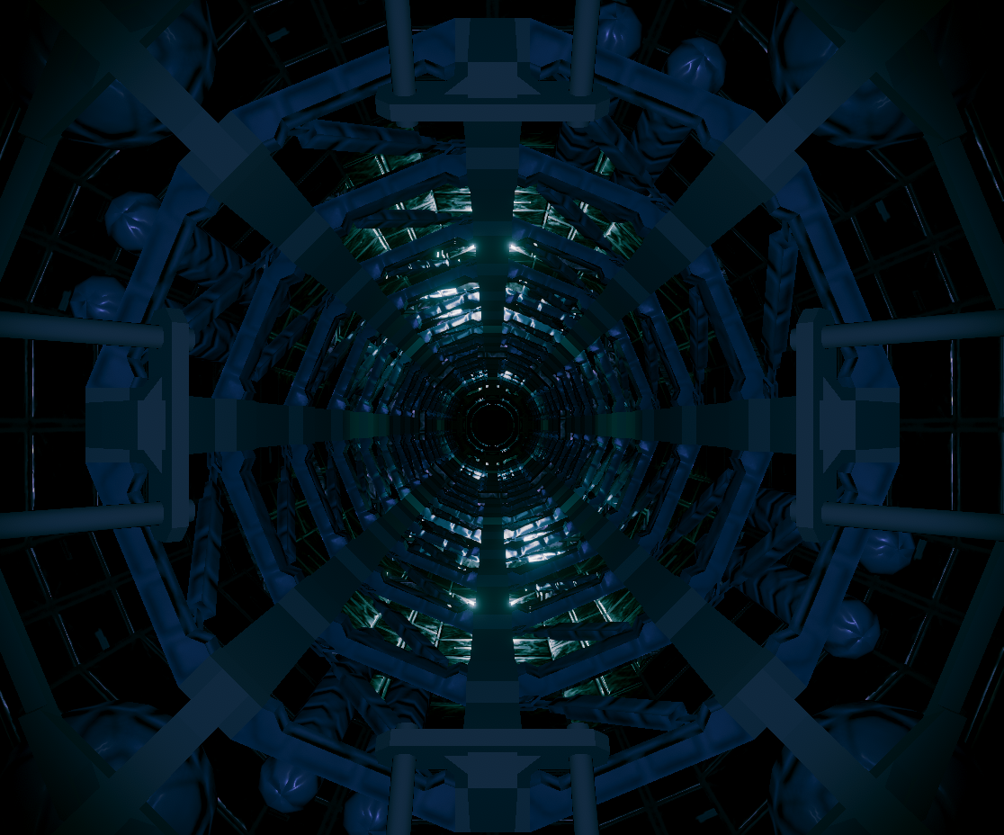
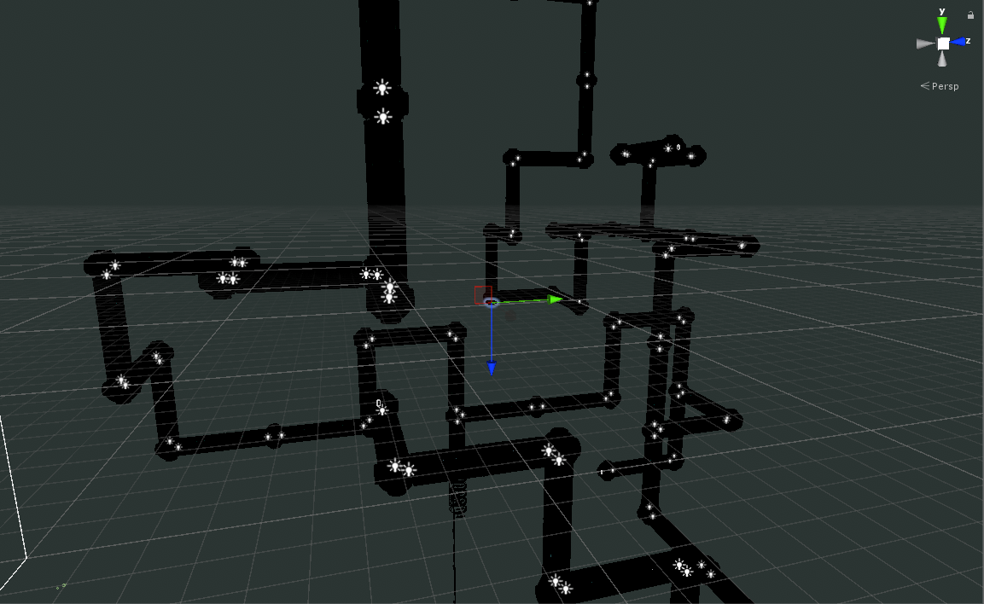

Slide 57
THE ‘PIPELINE’

Slide 58
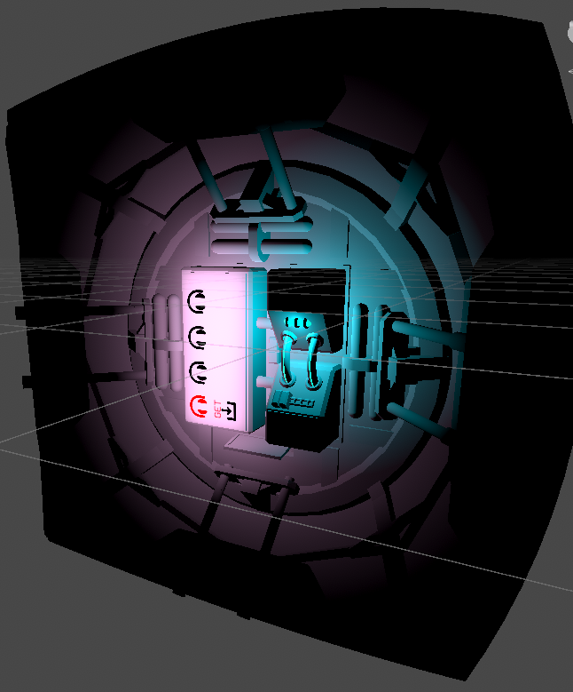
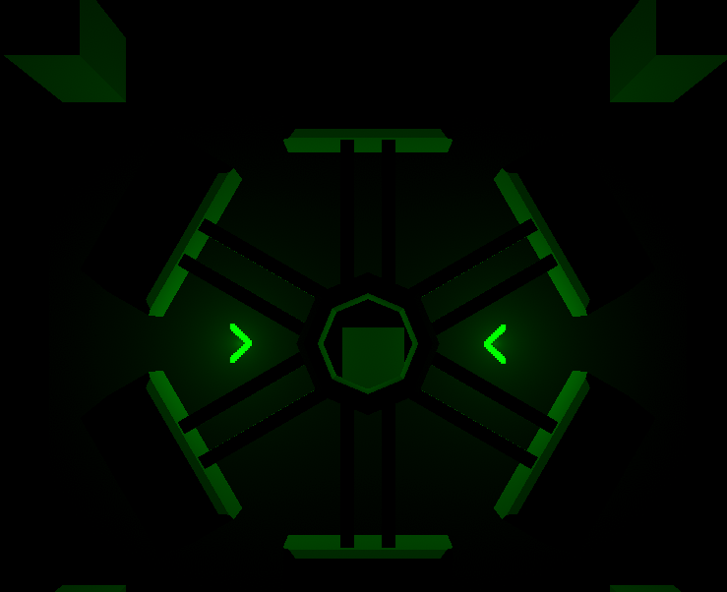
Tile Entities

Slide 59
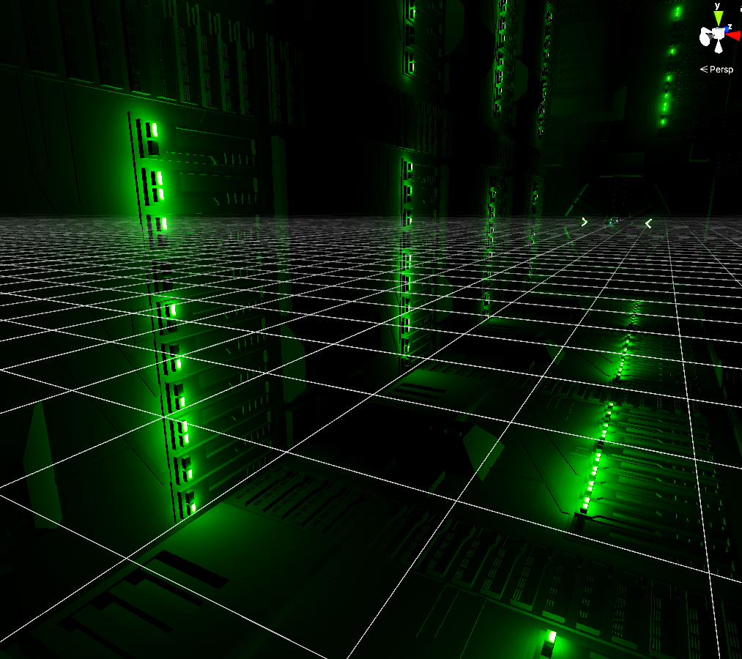
Tile Entities

Slide 60
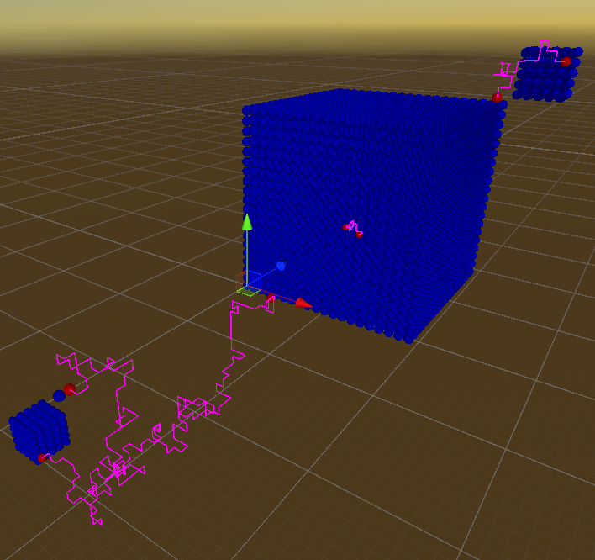
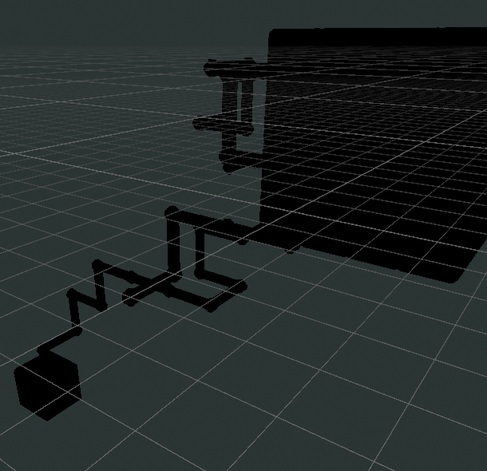
Generator And Renderer

Slide 61
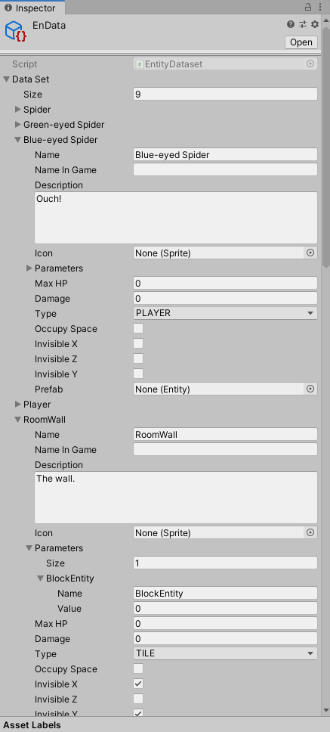
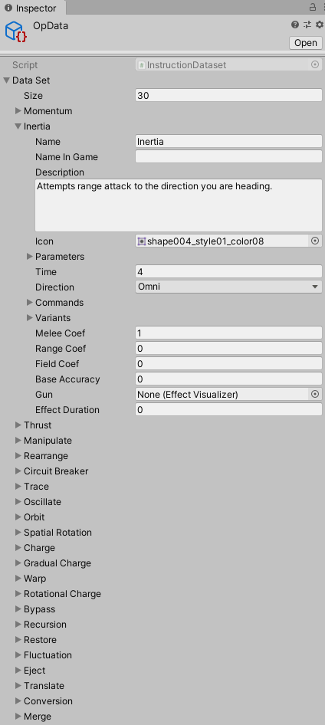
Data Decoupling

Slide 62
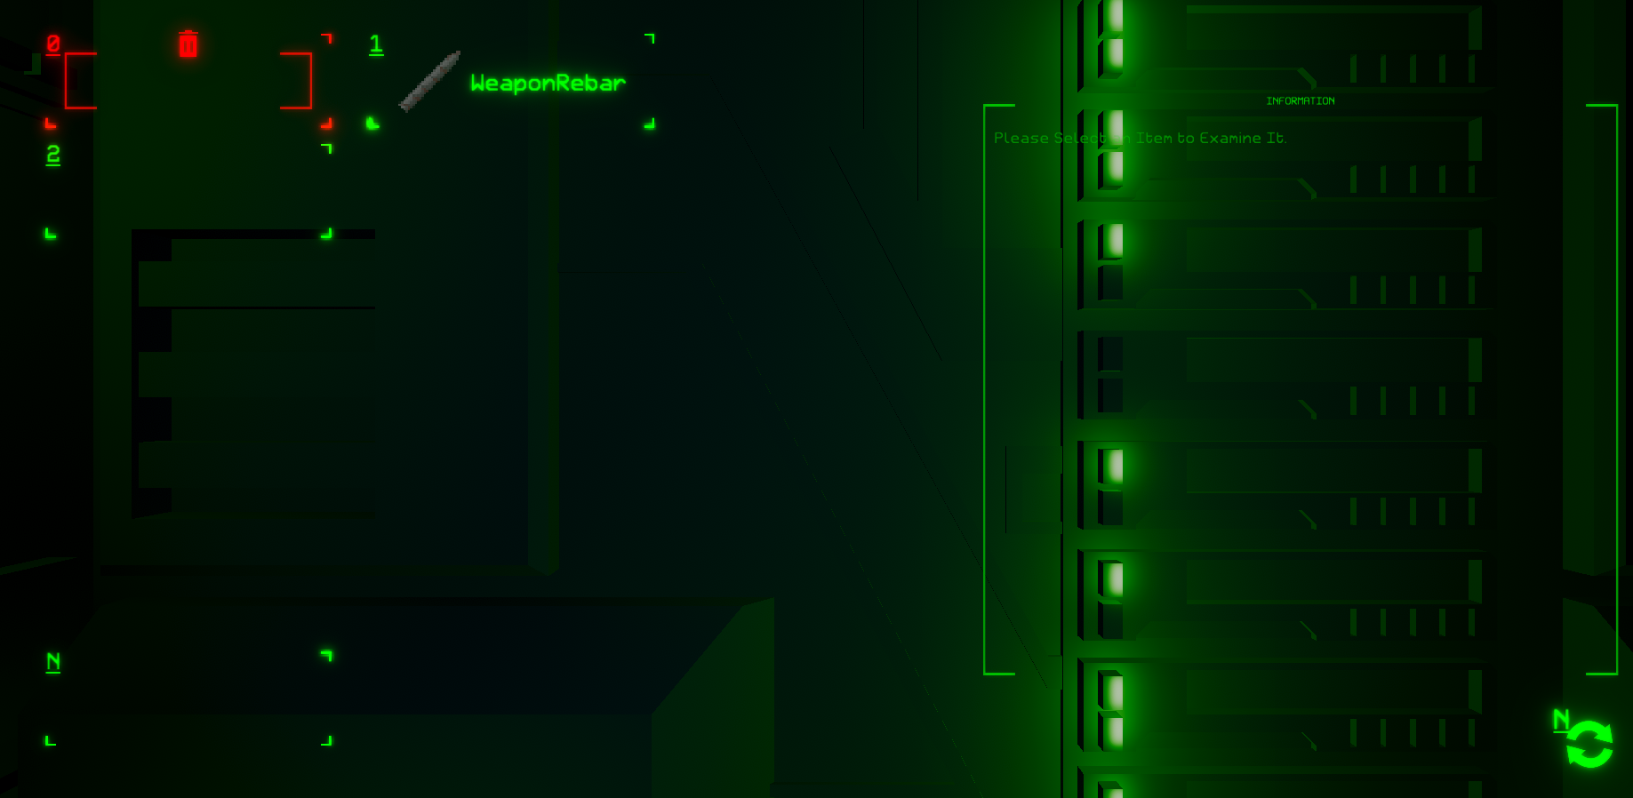
New UI/UX

Slide 63
WORKS DONE
Expandable level generator/renderer
Expandable entity system
Prototype enemy/AI
Item and Skills UI
Framework for various scripts: NPC dialogue, description, etc.

Slide 64
WORKS TO BE DONE
Save and Load
Music/Sound
Actual Fun Stuffs: Add Contents!
Enemies/Bosses
NPCs/Dialogues
New Map Features
New Weapons/Skills

Slide 65
Link: List of Tiles
Base: Walls, Pipes
Base feature could not be altered. They are generated on worldgen.

Slide 66
Cutoff
Additional Tiles: Traps, Barricades, Plants, Terminals
Additional features are installed on base feature, and could be destroyed when damaged.
Building the Base
Friendly Entities(drones, turrets, etc)
Communication System
Actual Fun Stuffs:
Reconstruction of map
Day/Night Cycle
Regions
Disasters
Bosses
NPCs/Dialogues
New Map Features
New Weapons

Slide 67
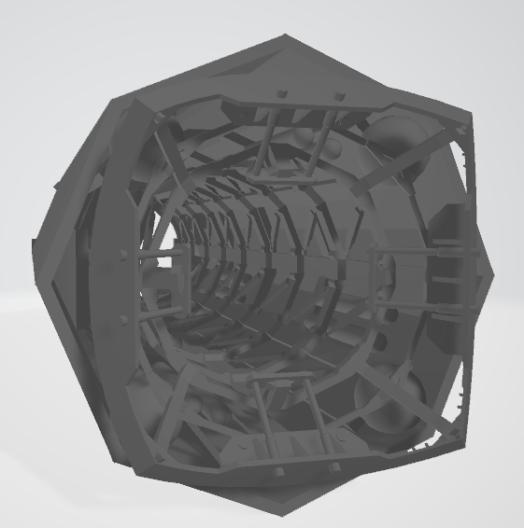
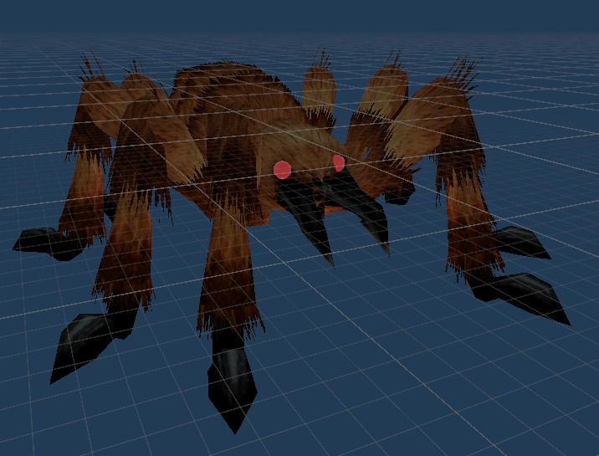

Join Our Team!
3D Modeling: map objects, mobs and creatures
Script Writing: Item/Mob/Terrain Description, Interactions

Slide 68
Join Our Team!
Sprites: UI, Item Icons, Skill Icons, On screen Effect

Slide 69
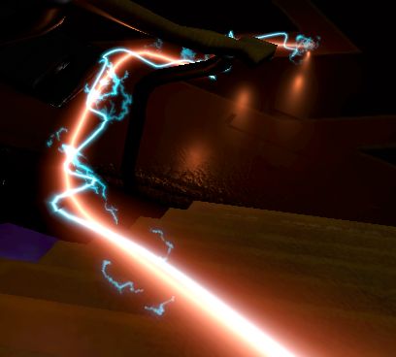
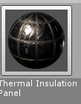
Join Our Team!
Coding (C#): Skill scripts, Item scripts, Mob AI, Mapgen, Save and Load
Particle system. (Skill, etc.)
Lighting and Materials

Slide 70
Thank You! We are waiting for you to join!

